Slide 1
Foundations of IxD: A path to IxD critique Interaction 09 | Vancouver
Dave Malouf
Professor of Interaction Design
Savannah College of Art & Design

Slide 2
Overview
Whom am I & how did I get here?
I promise it is relevant
Then who are you?
What is “Foundation”?
Foundation in education & practice?
Foundation relationship to critique
A case against “Foundation”
Let’s DISCUSS!
Notes:
Introductions
What is Foundation – an ID perspective
What does foundation mean for you
What is critique
A case against “Foundation”

Slide 3
Dave malouf
An Interaction Designer’s Tale
Notes:
Me! Start story waiting for next slide.

Slide 4
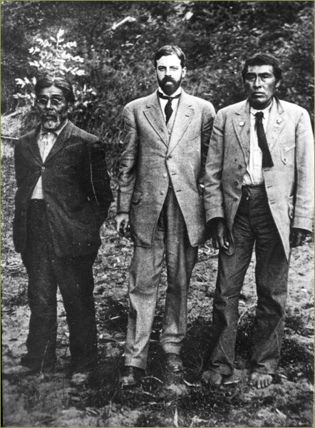
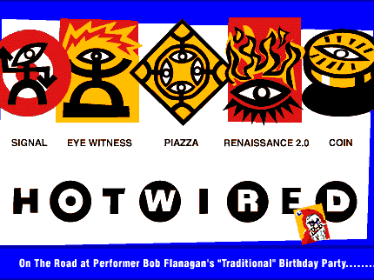



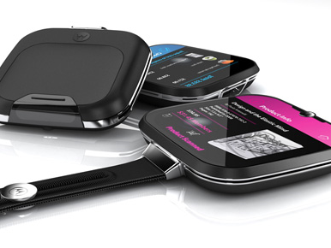
Notes:
UC Berkeley – learned to love people and be keenly aware of and appreciative and the subtleties of cross-cultural (even sub-cultural) differentiation in behavior.
1994 – Gave up the academic life to be an HTML Coder
Wax & Waned between Code, Design, Project Management

Slide 5
Who are you?

Slide 6
Are you …
Design educated?
Have a BFA or similar in …
Graphics
Communication
Industrial Design
Architecture
Worked in a design studio
HCI Educated?
Info Sys/Info Arch Educated?
Social Science Educated?
Other/Self?

Slide 7
foundation
An approach to design education a base for sound practice

Slide 8
What is Foundation?
Creates a solid base of core theories and crafts
These can transcend all design disciplines
Art History/Criticism
Color
2D Design
Goal is to give broad understanding of theory, and opportunity to focus on craft before diving deeper into your chosen discipline.

Slide 9
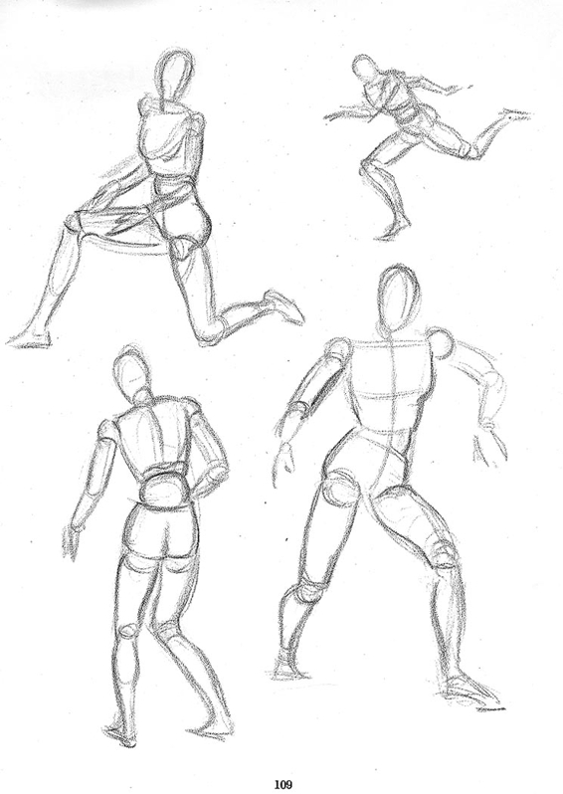
Design Education – Take 1 Basic skills + Practice
Draw
& Sketch
Color theory
2D
3D
History
Criticism
STUDIO (5x)
Theory & practice skills
Notes:
Theory & Practice is a combination of soft skills and supporting theories
Speaking and presenting
Human Factors
Applied Creative Thinking

Slide 10
Design Education – Take 2 Pratt Institute – Brooklyn, NY
Sketch (a lot!)
Primitives
Craft
Practice
Everything is done in studio
Let’s go deeper here …

Slide 11
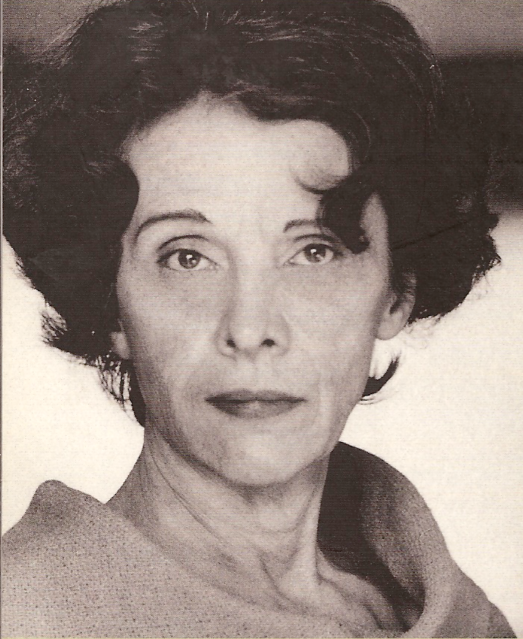
Meet Rowena Reed Kostellow Co-founder of Pratt Industrial Design
She actually preferred “3D design”
Primitive mastery was a key part of the Pratt School.
Extension of Bauhaus and other Euro design education practices
Notes:
Favorite quote:
“We introduce the student to an ordered sequence of purely visual experiences by which an *artist* may develop his understanding and his recognition of the abstract elements in any design situation. Our goal is the training of a designer so familiar with the principles of abstraction that he automatically thinks of a visual problem in terms of organized *relationships* and then feels free to study other aspects of the problem or to confer with specialists in related fields. He is a designer who can visually cross boundaries and suggest new forms for new materials or new techniques.”

Slide 12
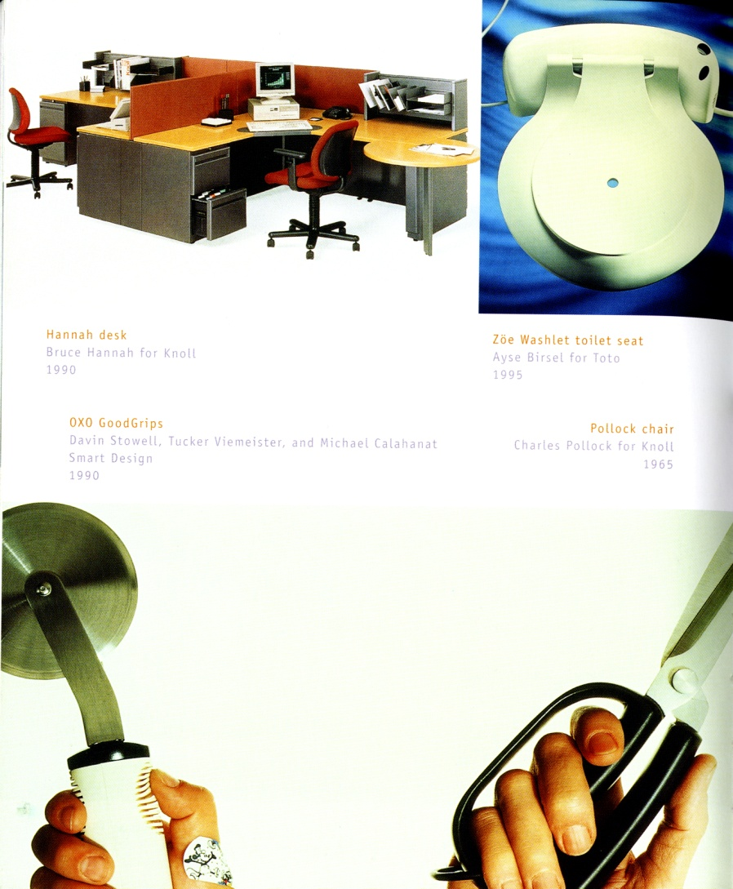
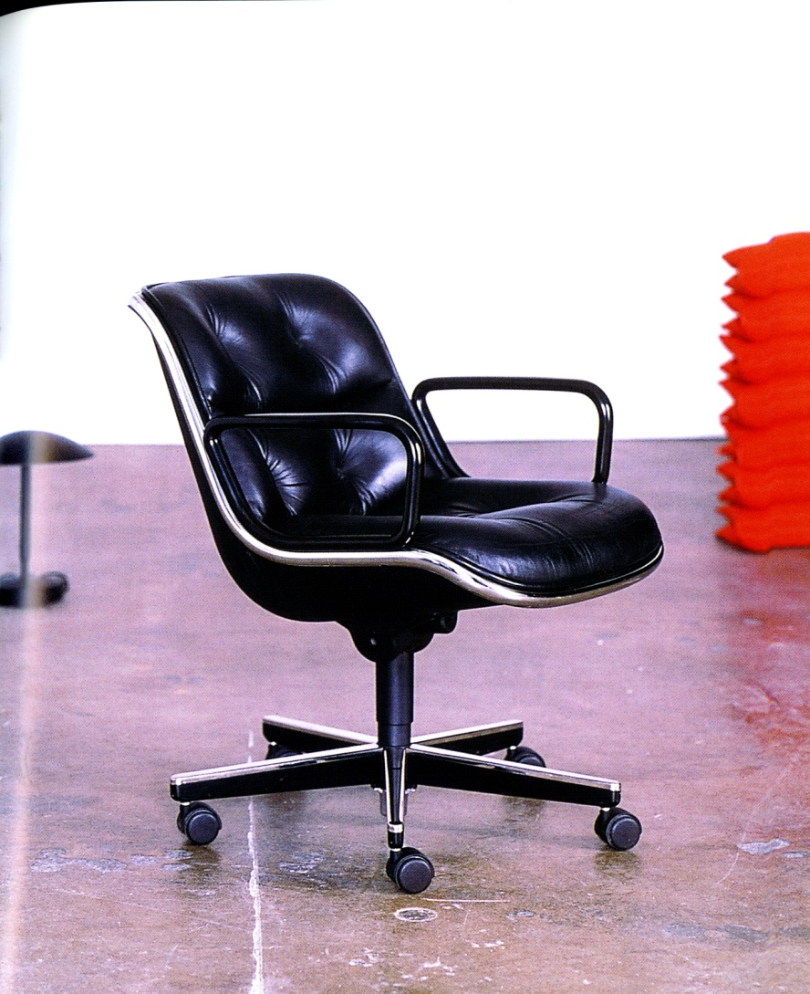
Her legacy is amazing!
Notes:
Bruce Hannah – Knoll
Tucker Viemiester – Oxo
Pollock - Knoll

Slide 13
What does it all mean?
What is Foundation (G-d Damn it!)?
There are 6 elements that every 3D designer needs to know:
Line
Plane (surface)
Volume (space & form)
Value (Light & Dark)
Texture
Color
Notes:
Line, Plane, Volume, Value, Texture & Color
This is what you are manipulating regardless of the medium/materials being used.

Slide 14
There is a also a progression
In 3D design you can’t just jump right in
“Primitives” must be mastered,
and in mastering these you master craft
Primitives include
Rectilinear Volumes
Curvilinear Volumes
Rectilinear & Curvilinear
Fragments
Planar constructions
Lines in Space
Advanced Studies in Form
Construction
Convexity
Concavity
Studies in Space
Studies in Space
Space Design

Slide 15
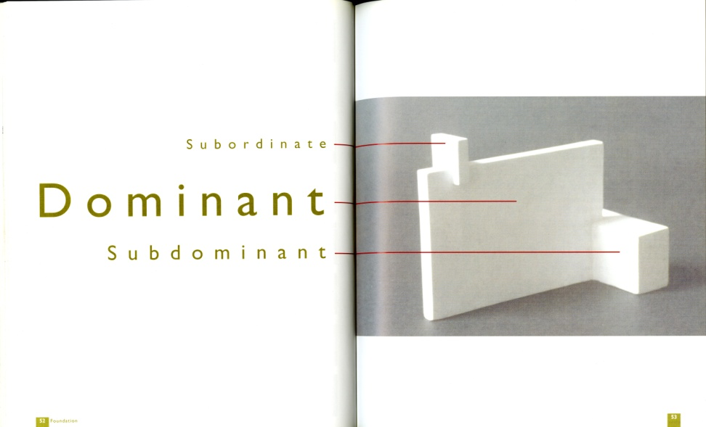
Why?
Well obviously to develop craft
But also to develop a design language
And practiced critique

Slide 16
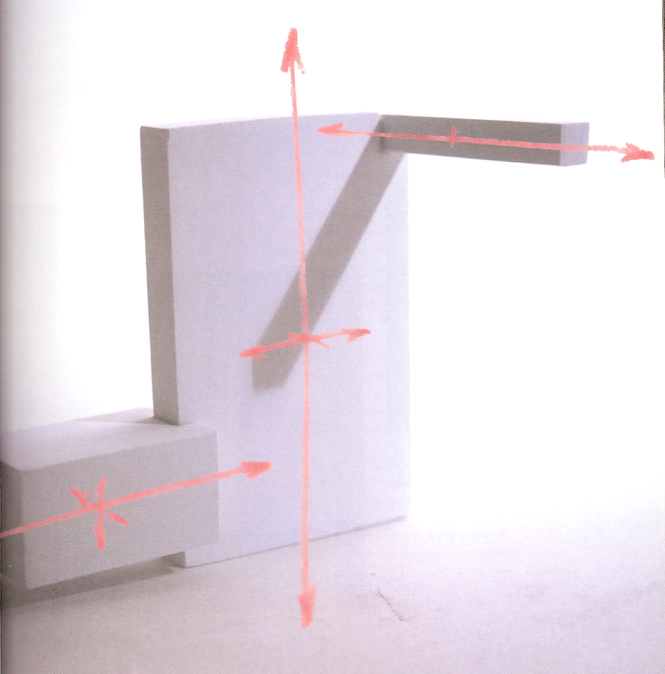
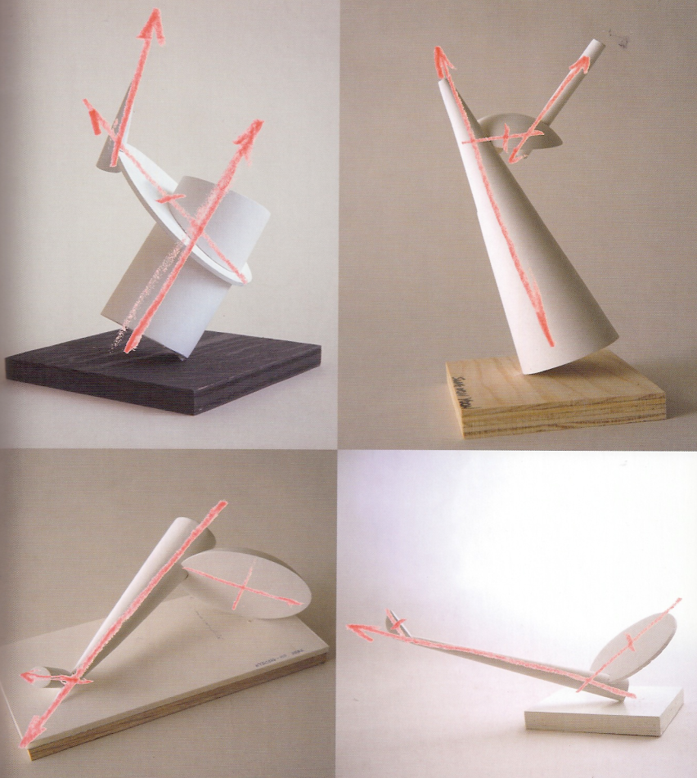
Primitive examples
Rectilinear Forms
Cylindrical Forms

Slide 17
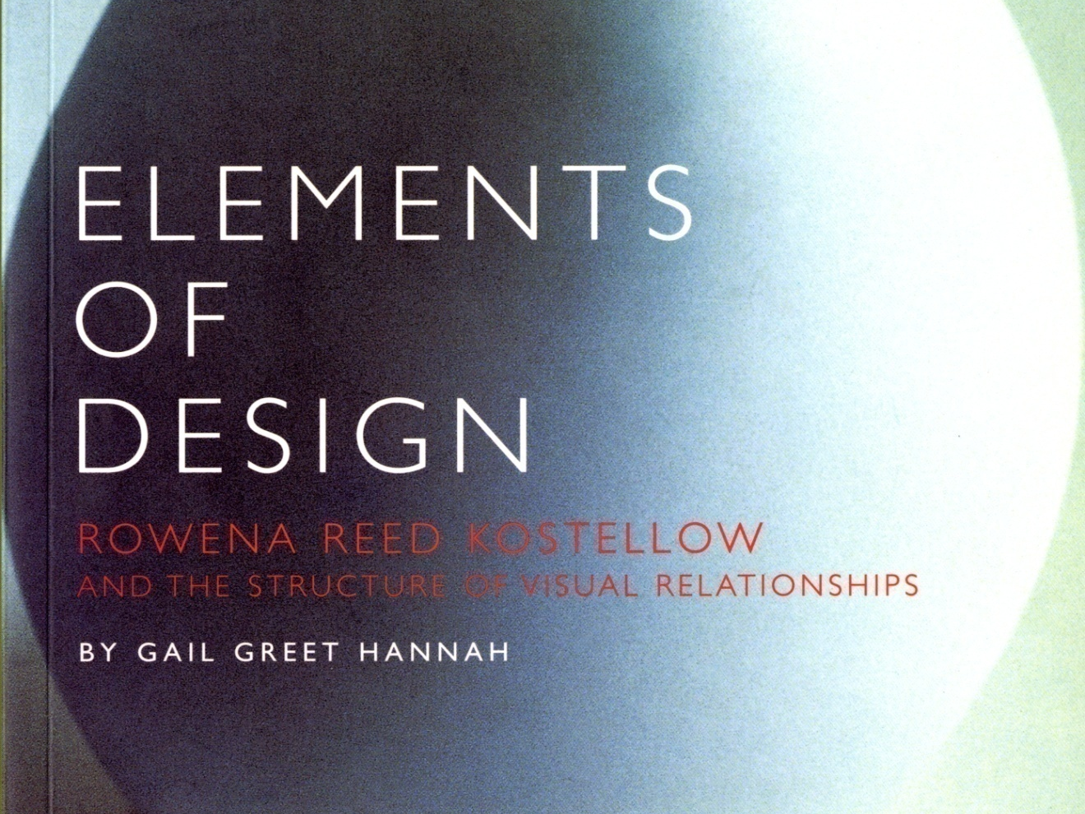
A nice read … changed my life!

Slide 18
What about ixd?
Sorry that took so long

Slide 19
Does IxD have foundations?
Not in any course, I have taken or seen
But still …
Do we build anything?
Is there something that we shape and mold even if that something is?

Slide 20
Wait!?! Am I the first to do this?
NO WAY!
I’m the first to call it “Foundations” or connect it directly to Pratt Foundation thinking.
So who else?
Jonas Löwegren
Pliability
Fluidity

Slide 21
Let’s get started So what are my element foundations?
Time
Abstraction
Metaphor
Negativity (for all of them)
Motion (recent addition)
Robert & Marc’s keynotes begs me to look deeper at “behavior”.
Can you craft emotional response?
What does it mean to “tug at someone’s heart strings?”

Slide 22

And where are aesthetic values?

Slide 23
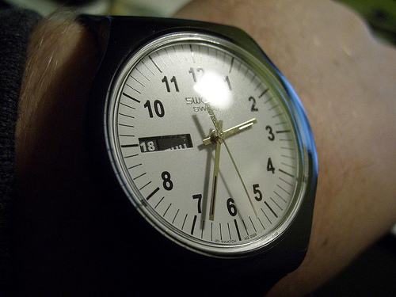
Time
Duration
Attention, or “posture”
Frequency
How many times in X period
Rhythm
Predictable or syncopated
Delay
In our response
In the system’s response
Adam Brodowski, IxD/ID Student @ SCAD

Slide 24
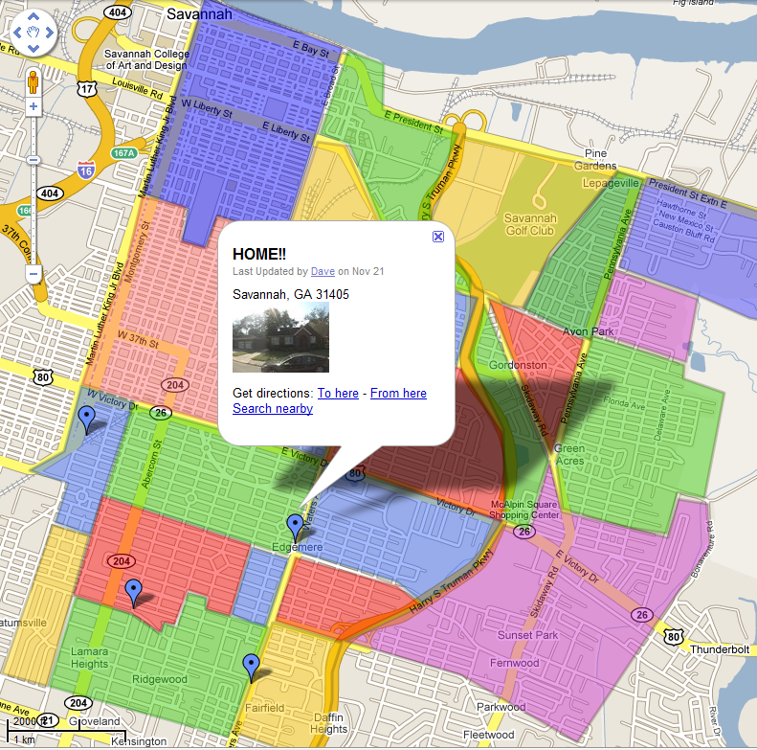
Abstraction
Level of directness or interaction
Command Line
Voice Command
Mouse – Point/Click
Stylus – Tap/Click
Finger – Tap Click
Movement equals same direction response.

Slide 25
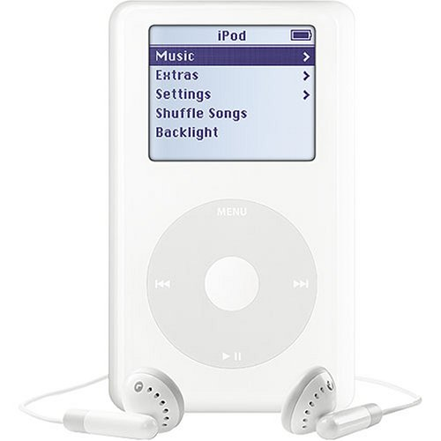
Another Example

Slide 26
Metaphors
Everything in computers is a metaphor
Dan Saffer, IA Summit 2005
Trash can/recycle bin
Disk
File/Folder
Shopping cart

Slide 27
Why metaphor
The virtual nature of digital interfaces
We need to map what we see to our real world thinking

Slide 28
Not absolute
Since all metaphors fail if we dive into them. Computer use is a lesson in knowing when to stop.
Notes:
Know your limits … beware of the trappings of “Bob”

Slide 29
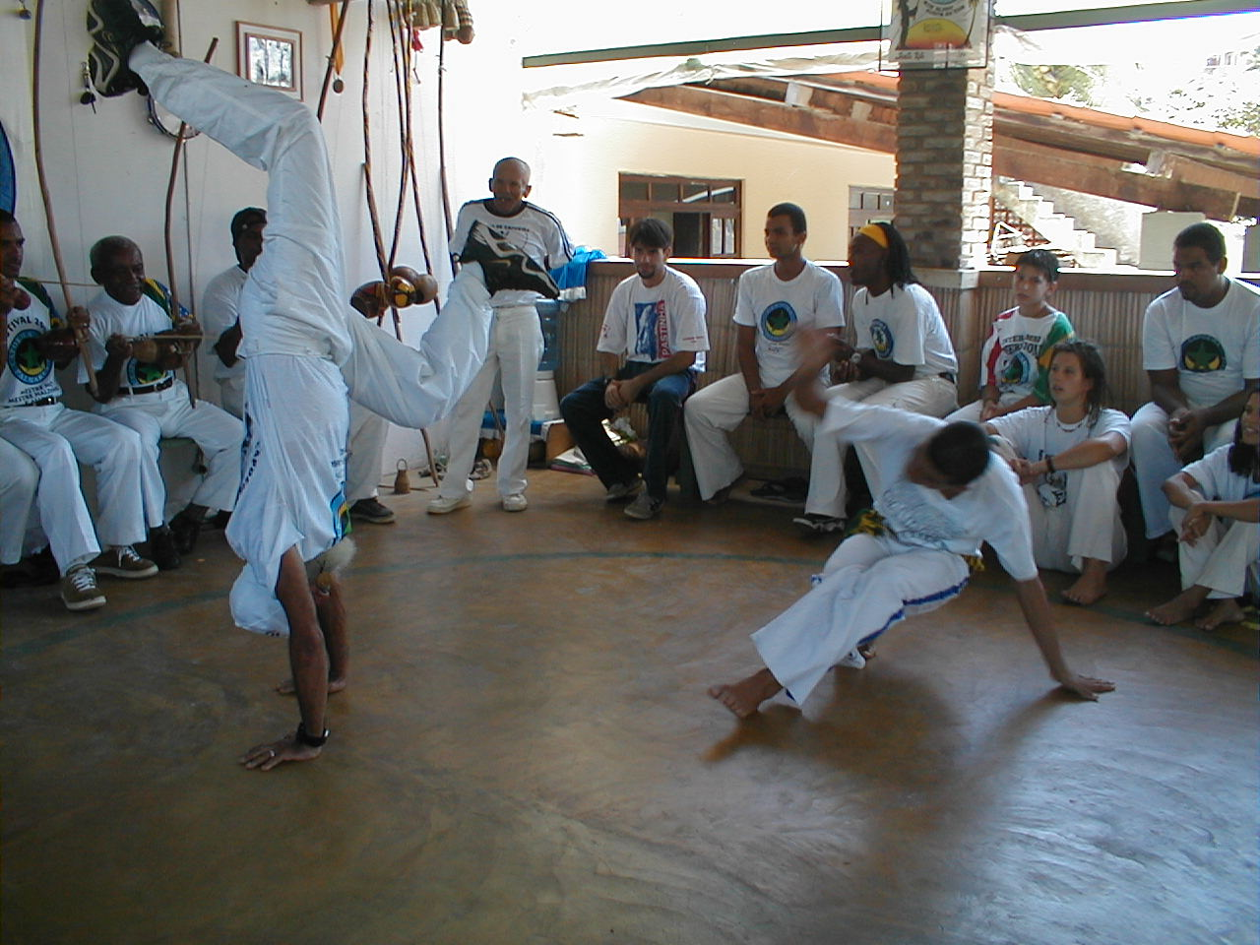
Movement has an aesthetic
Pleasing movements
Craft of motion
Intuitive gestures
Notes:
movement, interaction, etc. evoke emotion and have their own beauty. [Image of Capoeira comes to mind]
Using capoeira as it is a game, blending the interactions between the 2 in the circle with everyone around them.
There IS a reason why the click-wheel FEELS better, and why a flick is better than a scroll wheel or ball.

Slide 30
Behavior?
Can behavior be “material”?
Is it something we manipulate?
OR is it something, like experience: We craft the system that encourages, provokes and discourages.

Slide 31
Behavior
Behavior is not a material, but the response to material.
Akin to understanding
Behavior can’t be forced, but the conditions can be made so extreme as to insist. (Herd, Brainwash, Shock therapy)

Slide 32
What does this mean to me?

Slide 33
Putting it to practice
Having a language to share
Learning a basis for critique beyond usability evaluation
Evaluate aesthetic value systems

Slide 34
Tools are not enough
“Every tool is a weapon if you hold it right”
Ani Difranco
It isn’t the power of our tools that matter, but it is knowing what to do with them.
We need more than HCI to guide us.

Slide 35
Criticism Who here took art history?
Not rules
Language
Not patterns
Trends
emotions
Notes:
Its not that Heuristics & Patterns are bad, but IxD as a design discipline needs more.

Slide 36
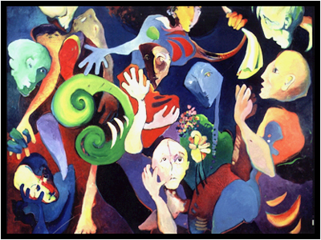
It’s what creates value in a Picaso
Beauty is not the same as “liking”, but is an unavoidable emotional response. Ugly is not the opposite for Beauty.

Slide 37


It’s how we make judgments of quality Pick the timeless icon!
Kitchen Aide
Cuisinart

Slide 38
A case against foundation

Slide 39

Gotta listen to the boss
SCAD Industrial Design Chair Tom Gattis
Concentrate more on thinking and processing skills
Less about creating beautiful objects
More about designing beautiful systems

Slide 40

In the end, balance will prevail
For IxD, unlike ID there are not enough leaders currently with mastery of IxD primitives.
Notes:
We really don’t have a practice grounded in a language of primitives of IxD and its associated foundations for communicating our designs.

Slide 41
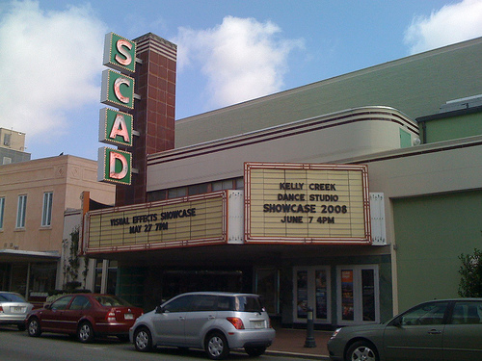
Questions? Comments?
David Malouf
http://davemalouf.com/
http://twitter.com/daveixd/
http://iact.in/ (SCAD IxD Students)
Notes:
“The artist is rimarly a visual person. I have always believed that there is no essential difference between the basic visual relationships that concern the fine artist, the graphic artist, the industrial designer, and the architect. The difference is in the degree of complexity of visual organization demanded by each situation. Beyond that, there are the materials and techniques of each area. I am convinced that there is a visual discipline suitable for all of these areas … It is [based on] the exciting concept that there can be order and structure to the organization of visual expression.”

